Slide 1
WAVELET AND HILBERT TRANSFORM BASED FEATURE EXTRACTION AND CLASSIFICATION
Submitted in the partial fulfillment for the award of the degree of
BACHELOR OF ENGINEERING
IN
COMPUTER SCIENCE WITH SPECIALIZATION IN
ARTIFICIAL INTELLIGENCE & MACHINE LEARNING
Submitted by:
22BAI71353 Chandraksh Narayan
22BAI71330 Gopal Krishan
22BAI71264 Aryan Bharat
22BAI71302 Deshaveni Akshar
Under the Supervision of:
Dr. AMIT KUKKER
Department of AIT-CSE
DISCOVER . LEARN . EMPOWER

Slide 2
OUTLINE
Problem Statement
Introduction
Background
Literature review
Methodology
Results
Conclusion

Slide 3
PROBLEM STATEMENT
This study aims to explore the efficacy of using brainwave EEG signals for sentiment analysis, employing Hilbert and wavelet transformations for feature extraction and reduction. The project seeks to compare the accuracy of various machine learning models when applied to the processed EEG data, thereby assessing their suitability for sentiment classification tasks in real-time applications.

Slide 4
INTRODUCTION
Sentiment analysis is crucial in modern data analysis for understanding emotions and opinions.
Traditional methods like NLP and facial recognition have limitations due to subjectivity and bias.
Recent advancements enable more objective emotion detection methods, such as analyzing brainwave EEG signals.
EEG signals offer direct insights into emotional experiences like happiness, sadness, stress, and excitement.
However, EEG signal analysis faces challenges due to complexity, randomness, noise, and non-stationarity.

Slide 5
Advanced techniques like wavelet and Hilbert transformations are needed for accurate feature extraction from EEG data.
Wavelet transform captures global and local frequency changes, while Hilbert transform extracts instantaneous frequency.
This study aims to classify emotional experiences using EEG data and advanced signal processing techniques.
Extracted features will be used to train and evaluate classification algorithms for better sentiment analysis accuracy.

Slide 6
BACKGROUND
Prior research demonstrates:
Proof of concept: classifying sentiment (positive, negative, neutral) using HT/WT features from EEG signals.
Feature extraction methods: utilizing HT for instantaneous information (phase/amplitude) and WT for wavelet coefficients at specific decomposition levels, revealing links between emotions and EEG characteristics.
Machine learning integration: combining HT/WT features with machine learning for automated emotion classification.

Slide 7
Existing research:
2014: 94.7% accuracy for emotion recognition using EEG with Empirical Mode Decomposition (EMD), Hilbert-Huang Transform (HHT), and Support Vector Machines (SVM) [Ref 1].
2018: 87.5% accuracy using digital filters for decomposition, EMD/Hilbert Transform/Discrete Wavelet Transform (DWT) for features, and SVMs for classification.

Slide 8
LITERATURE REVIEW
EEG signals are increasingly explored for emotion recognition due to their accessibility and temporal resolution.
Challenges include the complexity and non-stationarity of EEG signals, which can hinder traditional analytical procedures.
Techniques like Continuous Wavelet Transform (CWT), Short-Time Fourier Transform (STFT), and entropy-based metrics are employed for feature extraction and analysis.
EEG-based emotion analysis holds promise for applications in healthcare, human-computer interaction, marketing research, and brain-computer interfaces.

Slide 9
Studies typically involve recording EEG signals while exposing participants to stimuli designed to evoke specific emotions, followed by rigorous preprocessing and artifact removal.
Various feature extraction methods, including wavelet entropy and spectral analysis, are combined with machine learning algorithms for emotion classification.
Encouraging results have been reported in accurately identifying emotional states from EEG signals, with notable accuracy rates achieved for arousal, valence, and other dimensions.

Slide 10
S. No | Name | Dataset | Recognition Rate
1. | Empirical mode decomposition (EMD) and discrete Fourier transform (2013) | EEG signals | 52%
2. | Supervised dimensionality reduction (2017) | Mahnob-HCI database | 66.1(arousal) 64.1(valence)
3. | Frequency Domain Features and Support Vector Machines (2011) | Self-Generated | 66.51 %
4. | Combination of Spatial Filtering and Wavelet (2010) | Self-generated | 83.04 %
5. | Kernel Eigen-Emotion Pattern and Adaptive Support Vector Machine (2013) | Self-generated | 73.42-80 %
6 | Higher order Crossings method (2010) | Self Generated | 83.3%
Table: Related works in Sentiment analysis using EEG signals

Slide 11
METHODOLOGY
Proposed methodology for emotion detection from EEG signals using wavelet and Hilbert transforms.
Wavelet transform offers time localization and frequency decomposition but can lead to high-dimensional feature spaces and overfitting.
Hilbert transform provides insights into phase dynamics but is sensitive to noise levels and boundary effects, which are addressed in the study for improved accuracy and reliability

Slide 12
Data Acquisition:
Utilize an openly available EEG dataset containing recordings from subjects experiencing various emotional states (positive, neutral, negative).
Preprocessing steps applied to the raw EEG data include enhancing signal quality, artefact removal, filtering to eliminate noise, unwanted frequency components, baseline correction, and segmentation into epochs corresponding to specific emotional states.
The dataset comprises EEG signals collected from multiple electrode locations on the scalp, providing comprehensive neural activity information during different emotional states.

Slide 13
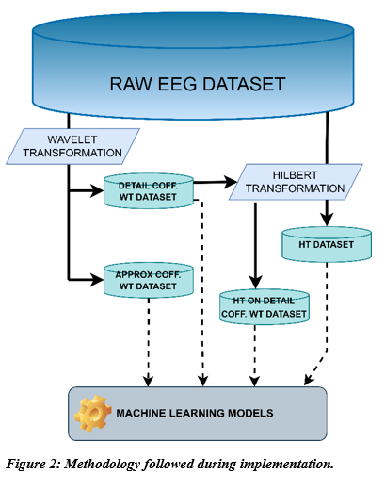
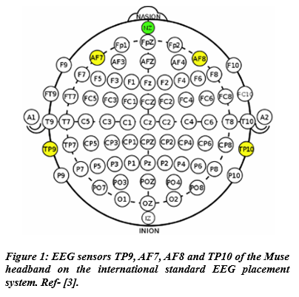

Slide 14
Wavelet Transform:
Purpose: Multi-resolution analysis to capture high & low-frequency components.
Method: Wavelet transform for signal decomposition based on frequency.
Wavelet Selection: 'db4’ was chosen for effectiveness with EEG signals.
Decomposition Level: "One" to avoid overfitting and excessive data (1500 columns).

Slide 15
Hilbert Transform:
Purpose: Compute analytic representation for instantaneous properties (amplitude, phase).
Method: Hilbert transform (unlike Fourier transform) focuses on instantaneous features.
Analytic Signal: Conversion to complex-valued function with 90-degree phase shift.
Edge Effect Mitigation: Zero-padding technique to reduce influence of endpoints on boundaries.

Slide 16
RESULTS
The highest classification accuracy of 95.04% was achieved using Light Gradient Boosting Machine on the approximation coefficients obtained through Wavelet transformation.
Similarly, employing a K-Nearest Neighbors Classifier on Hilbert transformed data yielded an accuracy of 95.44%.
Combining both Wavelet and Hilbert transformations with K-Nearest Neighbors Classifier resulted in an accuracy of 95.31%.
These findings demonstrate the potential of machine learning coupled with appropriate signal processing techniques, particularly Wavelet Transform, for accurate emotion recognition using EEG data.

Slide 17
MODEL | ACCUARACY
K Neighbors Classifier | 94.23%
Extra Trees Classifier | 94.23%
Light Gradient Boosting Machine | 93.36%
Table: Highest model accuracies
on Detail coefficient(cD) Hilbert
Transform dataset.
MODEL | ACCUARACY
Light Gradient Boosting Machine | 95.04%
Gradient Boosting Classifier | 94.77%
Extra Trees Classifier | 93.84%
Table: Highest model accuracies on Approx coefficient(cA) Hilbert Transform dataset.

Slide 18
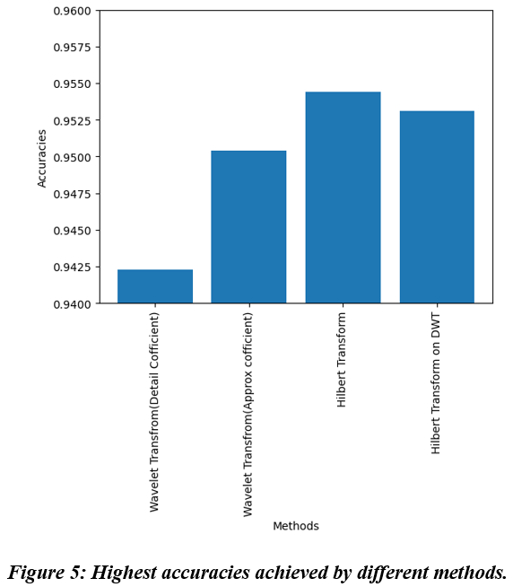
MODEL | ACCUARACY
K Neighbors Classifier | 95.31%
Extra Trees Classifier | 94.77%
Light Gradient Boosting Machine | 94.70%
Table 4: Highest model accuracies on dataset of Hilbert Transformed DWT (Discreate Wavelet Transform) dataset.

Slide 19
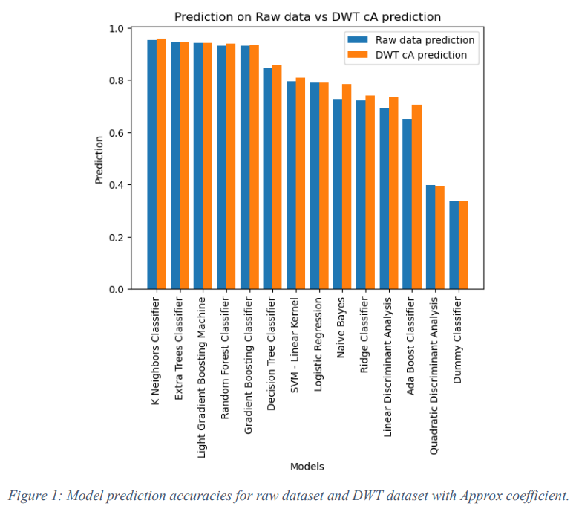
Accuracy of different model based on the EEG wave dataset.

Slide 20
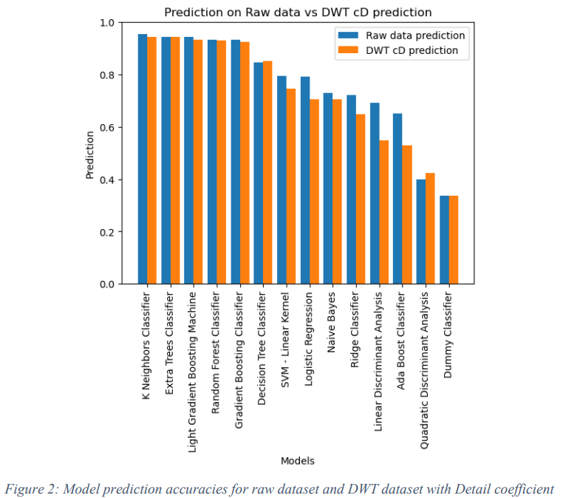
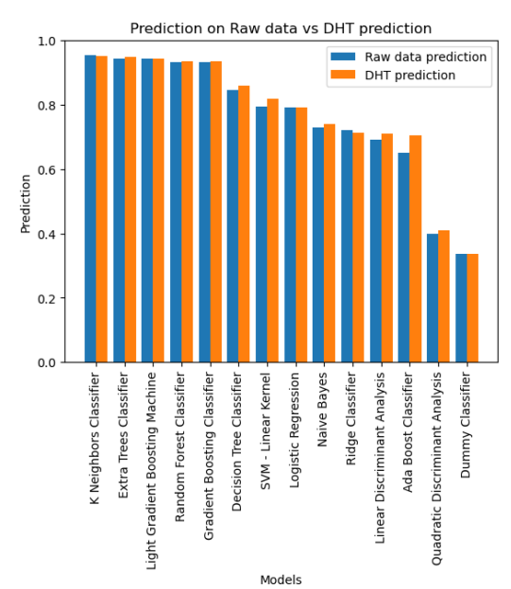

Slide 21
CONCLUSION
This research explored the effectiveness of machine learning for classifying human emotions (positive, neutral, negative) using EEG brainwave data.
Feature extraction from the raw signal and application of transformation methods like Wavelet and Hilbert transforms were implemented.
Subsequently, different machine learning models were trained and tested on the pre-processed data for emotion classification.

Slide 22
Future research directions could involve:
Expanding the dataset size and incorporating data from more subjects to improve generalizability.
Investigating the effectiveness of different wavelet functions and their impact on classification accuracy.
Exploring deep learning models specifically designed for EEG signal processing and emotion recognition.
Validating the developed models on real-world applications, such as emotion-aware human-computer interaction systems.

Slide 23
THANK YOU!!

